Slide 1


π
Agent
May 2024
π

Slide 2
π
Agent
Basics ?
What is a Tool
Tools type
Built-in tools
Custom tools
Way to create custom Tools
π

Slide 3
π
Argentic AI

Slide 4
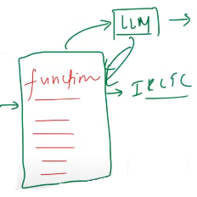
π
What is a Tool?
A tool is just a Python function (or API) that is packaged in a way so that LLM can understand and call when it is needed.
LLMs like GPT) are great at:
But they can't do things like:
Reasoning (Think)
Language generation (speak)
Access live data (weather, news)
Do reliable math
Call APIs
Run code
Interact with a database
Notes:
Content: https://www.linkedin.com/pulse/chunking-strategies-ai-data-kash-kashyap-0lghe/

Slide 5
π
Remark
If I ask LLM tell me hey LLM,What is best way to go from Delhi to Bombay.
So after thinking he will tell us flight is one option ,train is one option bus is another option ,but if I tell them to book my train. so LLM can book train ticket for you
Answer is no
LLM does not have power to perform any kind of task for you.So we can say that LLM is like a human body
Which have capability to think and speak. But body does not hand and legs
Which means it can not execute any task it's own. Today a lot of task available that computer system can do but llm can not
Like -live weather data ,
llm can do basic math like addition and subtraction, but it can not solve complex math problem, there is chance of hallucination means we can not trust the output of llm reliability issue .because llm did not learn how to solve math but it learn language generation
llm can not call external api, If you ask him tweet on twitter on my behalf then llm can not do it
They can not run code ,Can not interact with database
So real world computer system can perform many task but llm can not do
So as I said llm is like human body with brain that can think and speak but can not perform any task which means it does not have hands and legs
Notes:
Content: https://www.linkedin.com/pulse/chunking-strategies-ai-data-kash-kashyap-0lghe/

Slide 6
π
So what are tools
Tools is mechanism which helps to give hands and legs to llm .
Tools
Built in Tools
Custom Tools
Many the task which is required for everyone(built-in)
Google Search,Wikipedia,Run Command line tool
Notes:
Content: https://www.linkedin.com/pulse/chunking-strategies-ai-data-kash-kashyap-0lghe/

Slide 7
π
How Tools fits into the Agent ecosystem
An Al agent is an LLM-powered system that can autonomously think, decide, and take actions using external tools or APIs to achieve a goal.
Agent
Reasoning &
Decision making
Action
LLM
Tools
LLM
Weds
Tools
Agent
in nutshell the marriage of llm and tools ,we called agent
Notes:
Content: https://www.linkedin.com/pulse/chunking-strategies-ai-data-kash-kashyap-0lghe/

Slide 8
π
Built-in Tools
A built-in tool is a tool that LangChain already provides for you -it's pre-built, production- ready, and requires minimal or no setup.
You don't have to write the function logic yourself - you just import and use it.
DuckDuckGoSearchRun | Web search via DuckDuckGo
WikipedQueryRun | Wikipedia summary
ShellTool | Run shell commands
RequestsGetTool | Make HTTP GET requests
GmailSendMessageTool | Send emails via Gmail
SqlDatabaseQueryTool | Run SQL queries
Notes:
Content: https://www.linkedin.com/pulse/chunking-strategies-ai-data-kash-kashyap-0lghe/

Slide 9
π
Custom Tools
A custom tool is a tool that we can define our self
Use them When:
We want to call our own api
We want to encapsulate business login
we want the llm to interact with your database, product or app
Notes:
Content: https://www.linkedin.com/pulse/chunking-strategies-ai-data-kash-kashyap-0lghe/

Slide 10
π
from langchain_community.tools import tool
#Step 1 - create a function
def multiply(a, b):
"""Multiply two numbers"""
return a*b # Step 2 - add type hints
def multiply(a: int, b:int) -> int:
"""Multiply two numbers"""
return a*b
# Step 3 - add tool decorator
@tool
def multiply(a: int, b:int) -> int:
"""Multiply two numbers"""
return a*b
result = multiply.invoke({"a":3, "b":5})
print(result)
print(multiply.name)
print(multiply.description)
print(multiply.args)
#Llm see below response only from tools
print( multiply.args_schema.model_json_schema())
1
2
3
Notes:
Content: https://www.linkedin.com/pulse/chunking-strategies-ai-data-kash-kashyap-0lghe/

Slide 11
π
Way to Create Custom Tool Decorator
Way to create tool
using @tool decorator
using Structured tool and pydantic
Using BaseTool Class
Notes:
Content: https://www.linkedin.com/pulse/chunking-strategies-ai-data-kash-kashyap-0lghe/

Slide 12
π
Using @tool Decorator
Mostly We Used it
from langchain_community.tools import tool
#Step 1 - create a function
def multiply(a, b):
"""Multiply two numbers"""
return a*b # Step 2 - add type hints
def multiply(a: int, b:int) -> int:
"""Multiply two numbers"""
return a*b
# Step 3 - add tool decorator
@tool
def multiply(a: int, b:int) -> int:
"""Multiply two numbers"""
return a*b
result = multiply.invoke({"a":3, "b":5})
print(result, multiply.name , multiply. Description , multiply.args)
#Llm see below response only from tools
print( multiply.args_schema.model_json_schema())
1
2
1
@tool
Decorator
3
Notes:
Content: https://www.linkedin.com/pulse/chunking-strategies-ai-data-kash-kashyap-0lghe/

Slide 13
π
Using StructuredTool Class?
from langchain_community.tools import StructuredTool
from pydantic import BaseModel,Field
from typing import Type
#baseModel Used for Pydantic Model
class MultiplyInput(BaseModel) :
a:int=Field( required=True,description="first number to multiply")
b:int=Field(required=True,description="second number to multiply")
def multiply_fun(a:int,b:int) ->int:
return a*b
# StructuredTool
multiply_tool=StructuredTool.from_function(
name="Multiply",
description="Multiply to two number",
args_schema=MultiplyInput,
func=multiply_fun
)
result=multiply_tool.invoke({"a":22,"b":2})
print(result)
Notes:
Content: https://www.linkedin.com/pulse/chunking-strategies-ai-data-kash-kashyap-0lghe/

Slide 14
π
Using BaseTool Class?
BaseTool is the abstract base class for all tools in LangChain.
It defines the core structure and interface that any tool must follow, whether it's a simple one-liner or a fully customized function.
Notes
All other tool types like @tool, Structured Tool are built on top of BaseTool
Notes:
Content: https://www.linkedin.com/pulse/chunking-strategies-ai-data-kash-kashyap-0lghe/

Slide 15
π
Mostly We Used it
from langchain_community.tools import tool,BaseTool
from pydantic import BaseModel,Field
from typing import Type
#arg schema by using pydanitic
class MultiplyInput(BaseModel):
a:int=Field(required=True,description="First numbe to add")
b:int=Field(required=True,description="second number to add")
class MultiplyTool(BaseTool):
name:str="Multiply"
description:str="Multiply tow numbers"
args_schema: type[BaseModel]=MultiplyInput
def _run(self, a:int,b:int):
return a*b
tool=MultiplyTool()
result=tool.invoke({"a":5,"b":4})
print(result) #result:20
Notes:
Content: https://www.linkedin.com/pulse/chunking-strategies-ai-data-kash-kashyap-0lghe/

Slide 16
π
Toolkits
A toolkit is just a collection (bundle) of related tools that serve a common purpose packaged together for convenience and reusability.
In LangChain:
A toolkit might be: GoogleDriveToolkit
And it can contain the following tools
GoogleDriveCreateFileTool: Upload a file
GoogleDriveSearchtool: Search for a file by name/content
GoogleDriveReadFileTool: Read contents of a file
Notes:
Content: https://www.linkedin.com/pulse/chunking-strategies-ai-data-kash-kashyap-0lghe/

Slide 17
π
from langchain_core.tools import tool
# Custom tools
@tool
def add(a: int, b: int) -> int:
"""Add two numbers"""
return a + b
@tool
def multiply(a: int, b: int) -> int:
"""Multiply two numbers"""
return a * b
class MathToolkit:
def get_tools(self):
return [add, multiply]
toolkit = MathToolkit()
tools = toolkit.get_tools()
print(tools[0].invoke({"a":3,"b":5}))
Toolkits
Notes:
Content: https://www.linkedin.com/pulse/chunking-strategies-ai-data-kash-kashyap-0lghe/

Slide 18
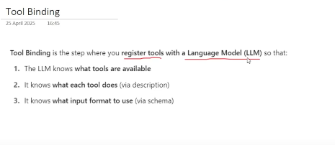
π
Tool Binding
Tool Binding is the step where you register tools with a Language Model (LLM) so that:
1. The LLM knows what tools are available
2. It knows what each tool does (via description)
3. It knows what input format to use (via schema)
Notes:
Content: https://www.linkedin.com/pulse/chunking-strategies-ai-data-kash-kashyap-0lghe/

Slide 19
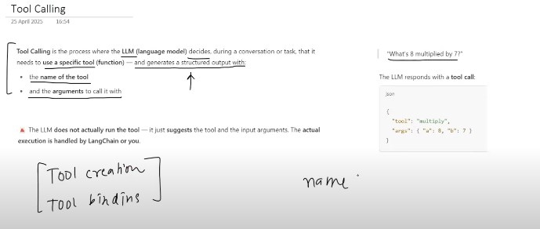
π
Tool Calling
Tool Calling is the process where the LLM (language model) decides, during a conversation or task, that it needs to use a specific tool (function) and generates a structured output with:
the name of the tool
and the arguments to call it with
"What's 8 multiplied by 7?"
The LLM responds with a tool call:
The LLM does not actually run the tool-it just suggests the tool and the input arguments. The actual execution is handled by LangChain or you(programmer).
json
{
"tool": "multiply",
"args": { "a": 8, "b": 7)
}
Notes:
Content: https://www.linkedin.com/pulse/chunking-strategies-ai-data-kash-kashyap-0lghe/

Slide 20
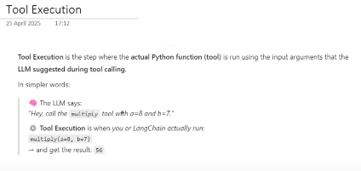
π
Tool Execution
Tool Execution is the step where the actual Python function (tool) is run using the input arguments that the LLM suggested during tool calling.
In simpler words:
The LLM says:
"Hey, call the multiply tool With a=8 and b=7."
Tool Execution is when you or LangChain actually run:
multiply(a=8, b=7)
→ and get the result: 56
Notes:
Content: https://www.linkedin.com/pulse/chunking-strategies-ai-data-kash-kashyap-0lghe/

Slide 21
π
from langchain_google_genai import ChatGoogleGenerativeAI
from dotenv import load_dotenv
from langchain_community.tools import tool
load_dotenv()
llm=ChatGoogleGenerativeAI(model="gemini-2.0-flash", temperature=0)
#tool create
@tool
def multiply(a:int,b:int)->int:
"""Given 2 numbers a and b this tool returns their product"""
return a*b
#tool binding
llm_with_tools=llm.bind_tools([multiply])
#tool calling
result=llm_with_tools.invoke("can you multiply 3 with 10")
#tool execution
data=multiply.invoke(result.tool_calls[0])
print(data)
# [ToolMessage(content='30' name='multiply' tool_call_id='89da71e1-0d84-4a14-a247-19f9165b3e55')]
Notes:
Content: https://www.linkedin.com/pulse/chunking-strategies-ai-data-kash-kashyap-0lghe/

Slide 22
π
from langchain_google_genai import ChatGoogleGenerativeAI
from dotenv import load_dotenv
from langchain_community.tools import tool
from langchain_core.messages import ToolMessage,HumanMessage,AIMessage
load_dotenv()
llm=ChatGoogleGenerativeAI(model="gemini-2.0-flash", temperature=0)
@tool
def multiply(a:int,b:int)->int:
"""Given 2 numbers a and b this tool returns their product"""
return a*b
llm_with_tools=llm.bind_tools([multiply])
query = HumanMessage("can you multiply 3 with 10")
messages = [query]
result=llm_with_tools.invoke(messages )
messages.append(result)
data=multiply.invoke(result.tool_calls[0])
messages.append(tool_result)
resp=llm_with_tools.invoke(messages).content
print(resp)
# 3 multiplied by 10 is 30.
Maintain Message History
Notes:
Content: https://www.linkedin.com/pulse/chunking-strategies-ai-data-kash-kashyap-0lghe/

Slide 23
π
Currency Conversion Tool
Notes:
Content: https://www.linkedin.com/pulse/chunking-strategies-ai-data-kash-kashyap-0lghe/

Slide 24
π
Notes:
Content: https://www.linkedin.com/pulse/chunking-strategies-ai-data-kash-kashyap-0lghe/

Slide 25
π
AI Agent
Agent
Reasoning &
Decision making
Action
LLM
Tools
AI Agent is LLM Powered system that can independently thick ,decide and take action using external tools or api calls to achieve a goal
LLM
Weds
Tools
Called Agent
Notes:
Content: https://www.linkedin.com/pulse/chunking-strategies-ai-data-kash-kashyap-0lghe/

Slide 26
π
LLM is Just like human body with only brain but there is not hands and legs.
means it can think and speak but can not perform any task
Just like if we ask how many difference way to we can go from Delhi to Bombay
it can answer
By Flight
By Train
By Bus another way
Ok.If we again ask can you book my ticket
LLM is no answer
Because it odes not have capability to perform any task
It can not call api
it can not tweet on my behalf
it can not connect to db.
means it is human body with only brain that can think and speak but not perform any task
Notes:
Content: https://www.linkedin.com/pulse/chunking-strategies-ai-data-kash-kashyap-0lghe/

Slide 27
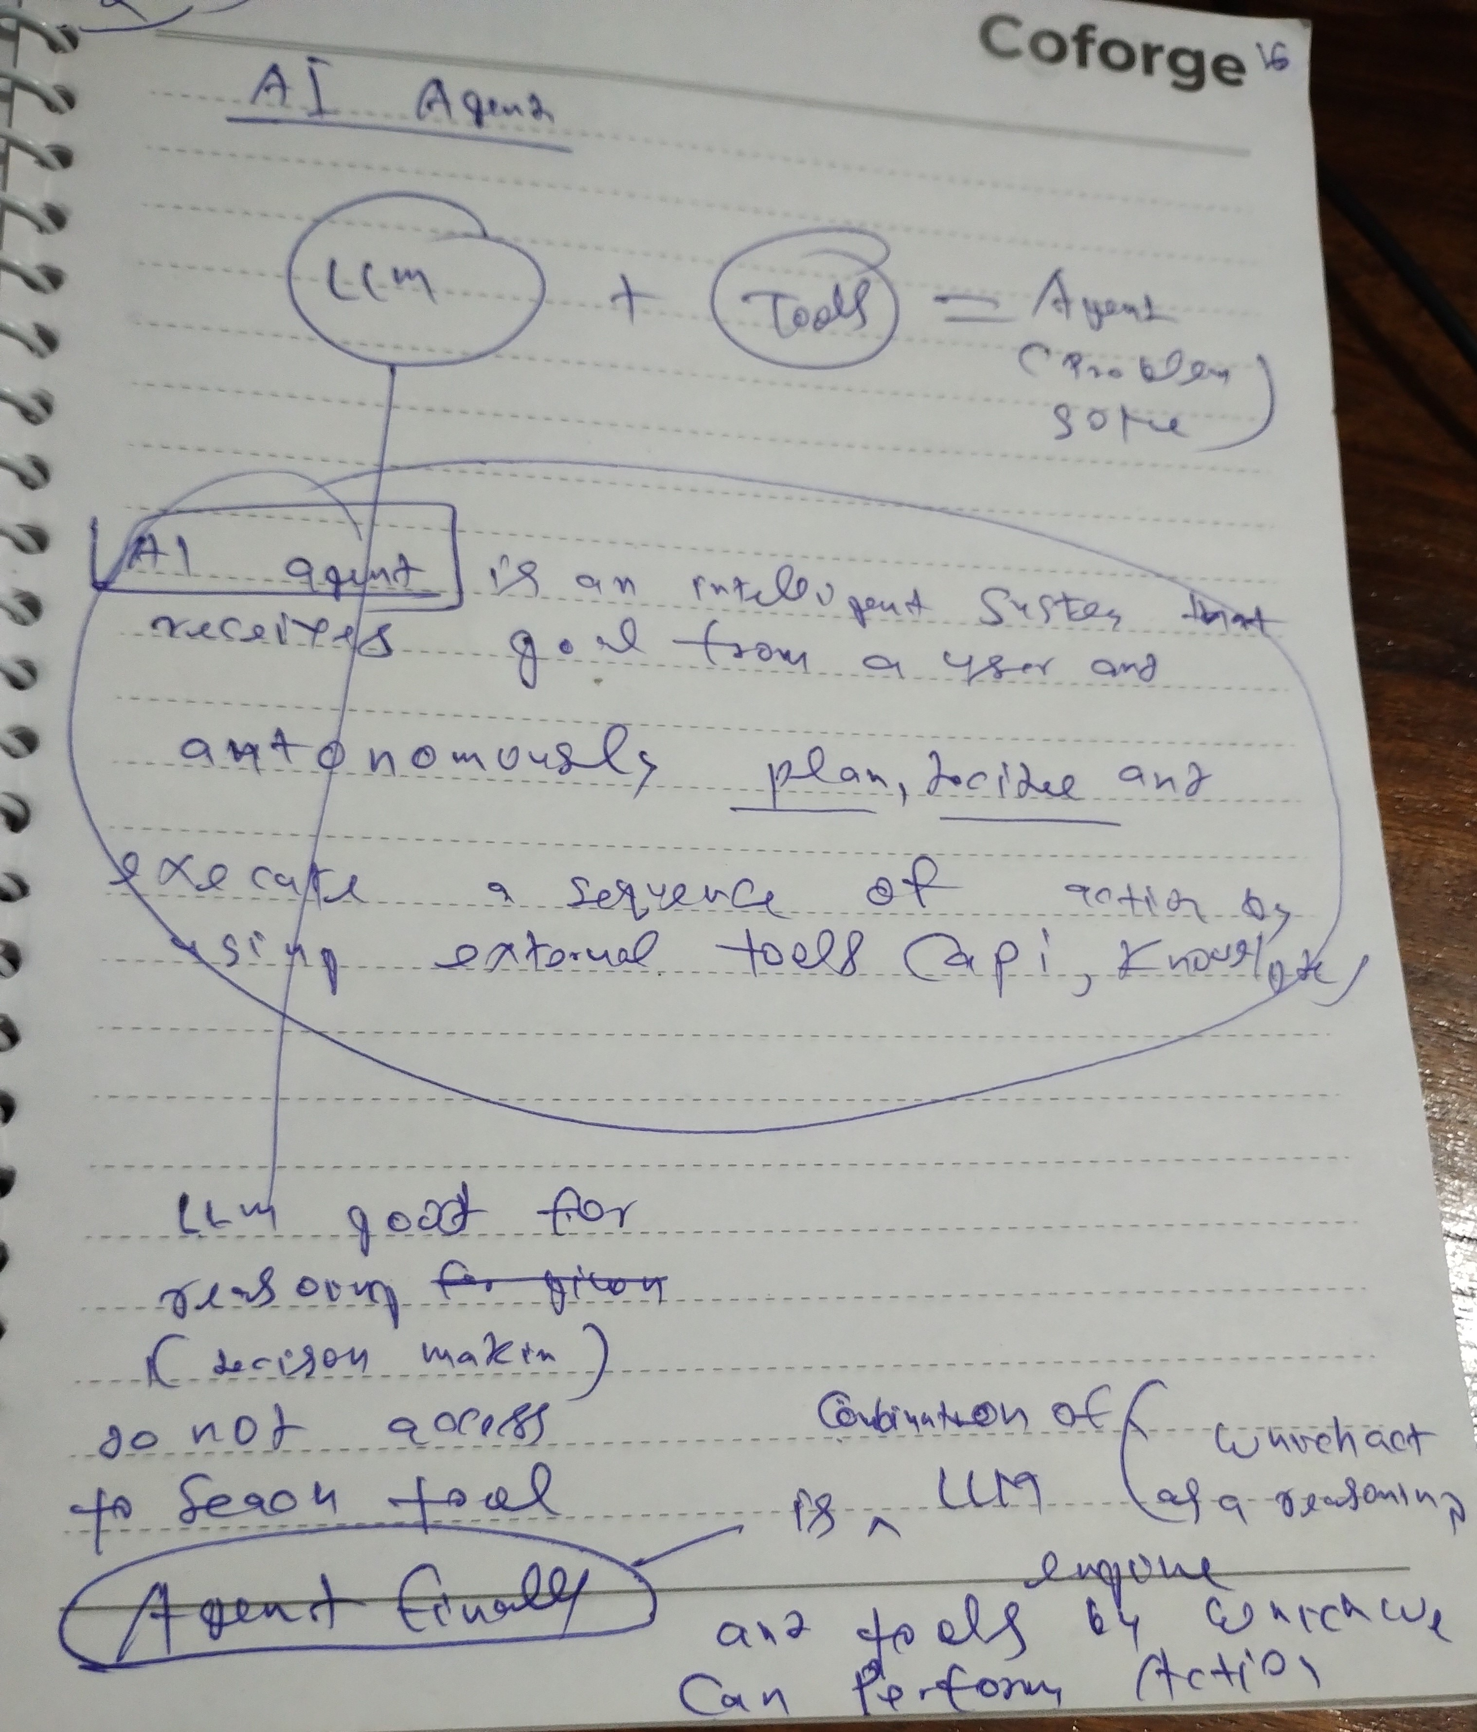
π
Notes:
Content: https://www.linkedin.com/pulse/chunking-strategies-ai-data-kash-kashyap-0lghe/

Slide 28
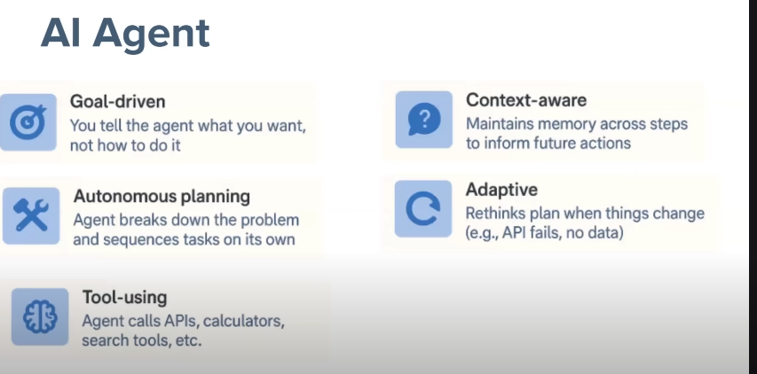
π
Characteries
Notes:
Content: https://www.linkedin.com/pulse/chunking-strategies-ai-data-kash-kashyap-0lghe/

Slide 29
π
Notes:
Content: https://www.linkedin.com/pulse/chunking-strategies-ai-data-kash-kashyap-0lghe/

Slide 30
π
Generative AI
Generative AI generate new content ,does not take any decision base upon input query
Notes:
Content: https://www.linkedin.com/pulse/chunking-strategies-ai-data-kash-kashyap-0lghe/

Slide 31
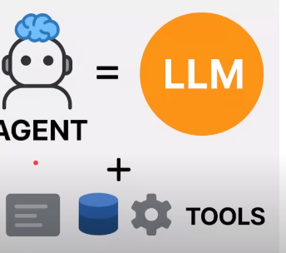
π
AI Agent
Main focuses on decision making to complete or perform a specific task
When multiple AI agents work together, their capabilities can grow exponentially. in place of focusing on just one task, multiple AI agents (or, an agentic AI system) can collaborate to handle complex workflows and achieve more advanced goals.
Notes:
Content: https://www.linkedin.com/pulse/chunking-strategies-ai-data-kash-kashyap-0lghe/

Slide 32
π
Agentic AI
AI agents can be considered as the building blocks,So agentic AI is a more complex setup or workflow that puts all of the building blocks together, allowing multiple agents to work together to achieve complex goals for an organization.
Notes:
Content: https://www.linkedin.com/pulse/chunking-strategies-ai-data-kash-kashyap-0lghe/

Slide 33
π
Notes:
Content: https://www.linkedin.com/pulse/chunking-strategies-ai-data-kash-kashyap-0lghe/

Slide 34
π
Notes:
Content: https://www.linkedin.com/pulse/chunking-strategies-ai-data-kash-kashyap-0lghe/

Slide 35
π
Notes:
Content: https://www.linkedin.com/pulse/chunking-strategies-ai-data-kash-kashyap-0lghe/

Slide 36
π
Notes:
Content: https://www.linkedin.com/pulse/chunking-strategies-ai-data-kash-kashyap-0lghe/

Slide 37


π
Q & A

